Slide 1
RUNGTA COLLEGE OF DENTAL SCIENCES AND RESEARCH
Preparation of Patient to receive Removable partial denture:Mouth preparation Periodontal,Endodontic,Surgical etc
Dept of Prosthodontics Part 1
3rd Year BDS
Presented By:
Dr.Shilpi Karpathak
Professor
Dept of Prosthodontics

Slide 2
Specific Learning Objective
Core areas | Domain | Category
Introduction Relief of Pain and Infection Completion of Required Surgical Procedures Correction of Occlusal Plane Discrepancies Correction of Malalignment | Cognitive | Must Know
Provision of Support for Periodontally Weakened Teeth Re-establishment of Arch Continuity Additional Considerations Reshaping Teeth Refining the cast restoration Rest Seat Preparations for Posterior Teeth | Cognitive | Must Know
 | Psychomotor | Must Know
Summary | Affective | Must Know

Slide 3
Contents
Introduction
Relief of Pain and Infection
Completion of Required Surgical Procedures
Correction of Occlusal Plane Discrepancies
Correction of Malalignment
Provision of Support for Periodontally Weakened Teeth
Re-establishment of Arch Continuity
Additional Considerations
Reshaping Teeth
Refining the cast restoration
Rest Seat Preparations for Posterior Teeth
Summary
references

Slide 4
introduction
Mouth preparation appointments must be planned with the goal of conserving as much time as possible.
The following discussion is arranged in the order that mouth preparation procedures are normally performed

Slide 5
Relief of Pain and Infection
Necessary endodontic and surgical procedures should be completed.
Carious lesions should be treated to decrease the likelihood that an acute episode of pain will occur during the course of treatment.
Gingival tissues should be treated to minimize the probability that periodontal abscesses and other inflammatory responses will occur.
Scaling, root planing, and prophylaxis should be performed, and a rigorous oral hygiene program should be established and carefully monitored.
Once the potential emergency-causing conditions have been addressed, the definitive treatment plan may be formulated

Slide 6
Completion of Required Surgical Procedures
teeth that have been deemed unrestorable, teeth that have insufficient periodontal support, and those that are unerupted or impacted.
eliminate tori or prominent exostoses that would complicate removable partial denture construction.
Preprosthetic procedures such as implant placement, ridge augmentation, and vestibular extension should be performed early in the treatment process.

Slide 7
Correction of Occlusal Plane Discrepancies
1.If supraeruption is relatively minor, the occlusal plane may be corrected by carefully recontouring the surfaces of the teeth.
2.If moderate supraeruption has occurred, correction of the occlusal plane may require the placement of cast restorations such as onlays or crowns.
3. If supraeruption is extreme, extraction of the offending teeth may be the only logical solution

Slide 8
4.In maxillary posterior regions, supraeruption also may be accompanied by a downward migration of the tuberosities.
As a result, the interarch space may be extremely limited and may preclude the placement of an acceptable prosthesis.
Surgical reduction of the tuberosities may be required to provide adequate restorative space.
5.tipped molars-The loss of premolars often allows adjacent molars to drift mesially. This mesial migration may be accompanied by tipping. The ideal solution is to upright such teeth orthodontically. Unfortunately, orthodontic correction is not alwayspossible, nor is it always desired by the patient.
In these situations, the occlusal plane may be reestablished in a number of ways.
If migration and tipping are minor, the occlusal plane may be corrected via enameloplasty. If migration and tipping are more severe, onlays or crowns may be indicated for correction of the occlusal plane

Slide 9
6. Severe discrepancies in the occlusal plane may require surgical intervention

Slide 10
Correction of Malalignment
Teeth that are out of alignment may create significant difficulties in removable partial denture service.
Orthodontic movement of malpositioned teeth should be the first option. Unfortunately, orthodontic therapy may not be possible for patients with few remaining teeth.
Minor malalignments may be corrected by recontouring the axial surfaces of the malposed teeth.
Moderate malalignments may be treated by placing crowns.
When malalignment is so severe that it renders a tooth unusable, consider extraction of the malposed tooth

Slide 11
Provision of Support for PeriodontallyWeakenedTeeth
These teeth may require some form of splinting to provide adequate support and stabilization for a removable partial denture.
Splinting may be accomplished using fixed restorations or designing the removable partial denture to join teeth as a functional unit.
Fixed splinting is accomplished by joining teeth with complete- or partial-coverage restorations.These restorations may be cast as a single unit or they may be cast individually and joined via soldering procedures.The objective is to gain improved resistance to applied forces

Slide 12
fixed splinting of posterior teeth will provide additional resistance to anteroposterior forces, but not mediolateral force.
To obtain improved resistance to mediolateral forces, fixed splinting must be extended to include one or more anterior teeth.
Inclusion of the canine is particularly important since this tooth occupies a position at the “corner” of the arch.Teeth located distal to the canine are oriented anteroposteriorly, while the canine and the remaining anterior teeth assume a mediolateral orientation. Due to its position, the canine provides a buttressing effect that yields significant lateral resistance

Slide 13
A major drawback of fixed splinting centers upon inability of the patient to adequately clean the splint.
Cost and projected longevity of such restorations also must be considered when deciding w
splinting also may be accomplished using properly designed removable partial denture.
involves the use of lingual plating in conjunction with multiple facially positioned clasp arms.
The encompassment provided by these components joins the teeth as a functional unit. This permits the even distribution of applied forces over an increased number of teeth and may improve the longevity of the remaining teeth.

Slide 14
A second option involves retaining both teeth and fabricating a removable partial denture with a direct retainer on the periodontally compromised tooth. This generally leads to accelerated failure of the periodontally compromised tooth and renders the removable partial denture unusable.
A third option involves extraction of the periodontally compromised tooth. The adjacent tooth may then be used as a removable partial denture abutment. Experience indicates that this option usually is the most suitable

Slide 15
Re-establishment of Arch Continuity
When a lone-standing abutment is present, should carefully examine the remainder of the arch to determine whether the patient would benefit from placement of a fixed partial denture.
An appropriately constructed fixed partial denture may be used to reestablish continuity of the dental arch and greatly improve the prognosis for removable partial denture therapy

Slide 16
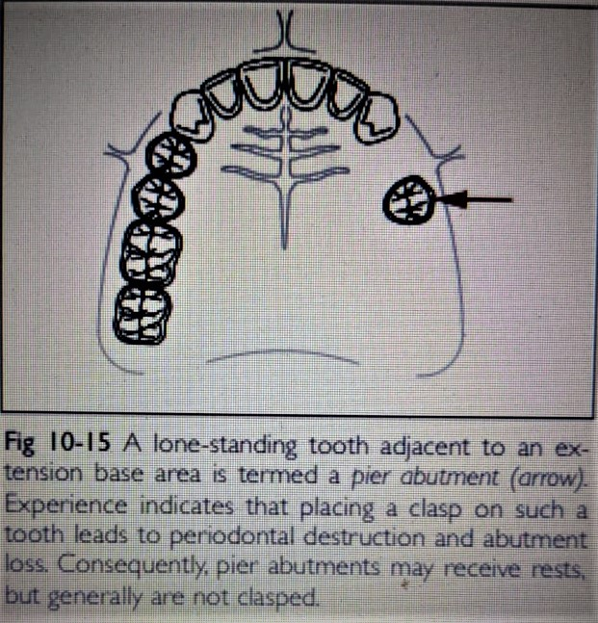
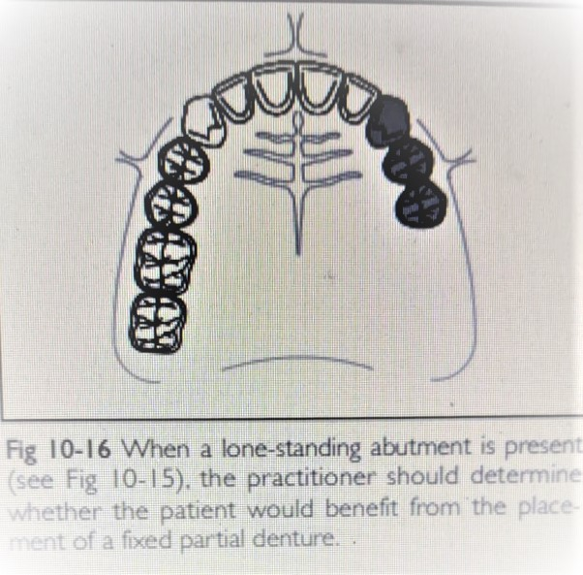

Slide 17
Additional Considerations
Teeth that have lost a moderate amount of supporting bone but display minimal mobility and are strategically positioned in the arch may be retained to provide support for removable partial dentures.
These teeth are intended to resist movement of removable partial dentures toward tissues during function.
If teeth that are located at the posterior end of a distal extension base, the prosthesis will function as a Class III removable partial denture rather than a Class I or Class II prosthesis.
This change improves the function and patient acceptance of the removable partial denture

Slide 18
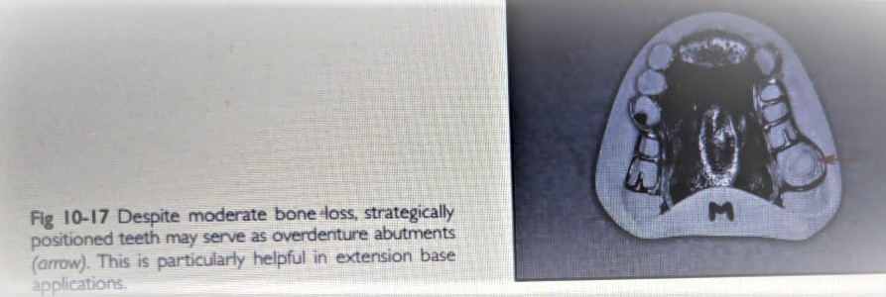

Slide 19
Reshaping Teeth
Enamel
on the surface of an existing restoration
by placing a new restoration.

Slide 20
1.Enameloplasty
Conservatism must be the rule.
If the desired recontouring can be accomplished in enamel, this procedure should be completed intraorally.
In turn, the prepared enamel surfaces should be highly polished.
To accomplish this, a carborundum-impregnated rubber wheel or point should be placed in a low-speed handpiece.
Light, intermittent pressure and moderate speed should be used during polishing procedures

Slide 21
Developing guiding planes
Guiding planes are surfaces on proximal or lingual surfaces of teeth that are parallel to each other and, more importantly, to the path of insertion and removal of a removable partial denture.
The diagnostic cast should be properly positioned on the surveying table and should be oriented at the tilt used during survey and design procedures.
During the mouth preparation process, the surveying table and cast should be readily accessible. This permits to visualize the desired relationship between a given dental bur and the tooth to be recontoured.
The same relationship can then be duplicated in the patient’s mouth.
This process allows to create guiding planes and other contours that are in harmony with the planned path of insertion.

Slide 22
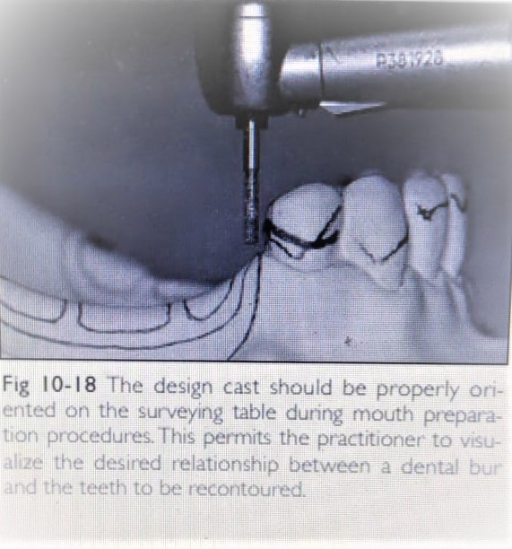
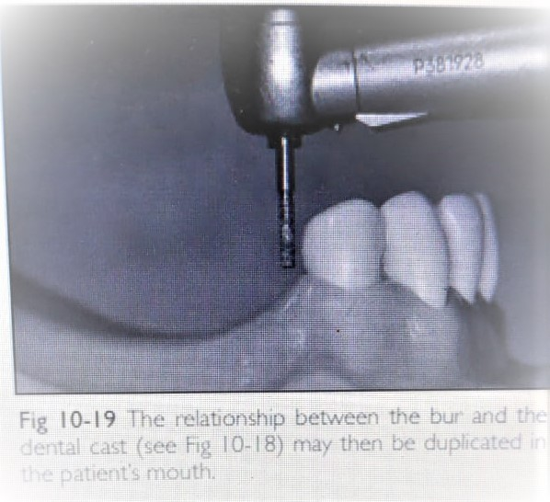

Slide 23
a.Abutment teeth adjacent to tooth-supported segments
A cylindrical diamond or carbide bur is generally used for the preparation of guiding planes.
The chosen bur is placed in a high-speed handpiece.
A light, sweeping stroke from the facial line angle to the lingual line angle is then used to create a gently curving plane.
This surface should be 2 to 4 mm in occlusogingival height, but should not resemble a straight slice when viewed from the occlusal or incisal surface. Instead, it should follow the natural curvature of the tooth surface.
At this stage, prepared surfaces are polished with a carborundum-impregnated rubber point or wheel in a low-speed handpiece.
Light, intermittent pressure is recommended to avoid undue generation of heat.

Slide 24
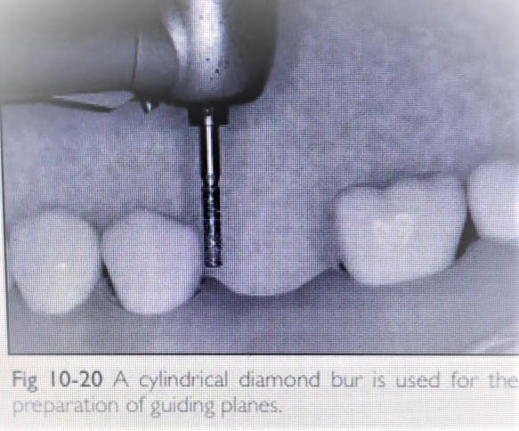
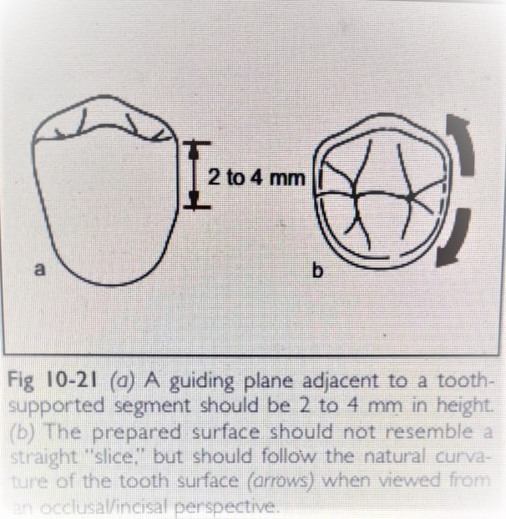

Slide 25
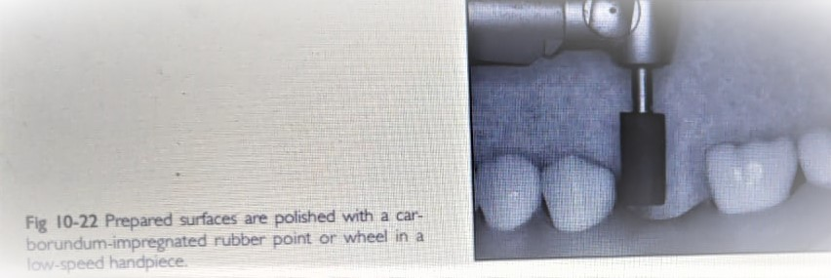

Slide 26
b. Abutment teeth adjacent to distal extension edentulous spaces
using the same armamentarium described in the previous section.
A guiding plane prepared adjacent to a distal extension space should be slightly shorter than a guiding plane prepared adjacent to a tooth-supported segment.
Typically, a guiding plane adjacent to a distal extension space is 1.5 to 2.0 mm in height.
The reduced height results in decreased contact with the associated minor connector (i.e proximal plate) and permits greater freedom of movement for the associated removable partial denture

Slide 27
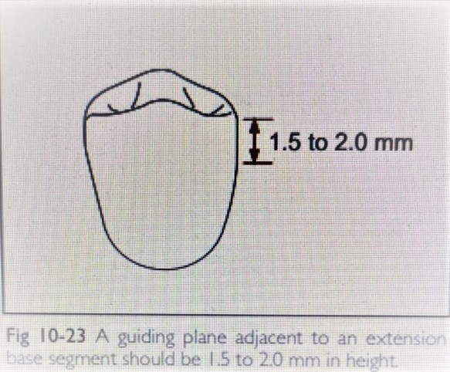
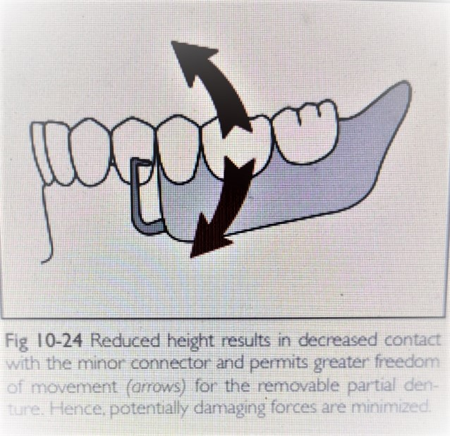

Slide 28
c.Lingual surfaces of abutment teeth
to enhance reciprocation
1.As a clasp assembly travels to or from its fully seated position, the retentive arm must pass over the height of contour. This places lateral forces on the abutment. Unless effective reciprocation is provided, these forces will lead to destruction of the supporting periodontal tissues.
To prevent this destruction,must ensure that the reciprocal element is in contact with the tooth as lateral forces are generated. This may be accomplished by using a vertical reciprocal element such as a lingual plate or by using a lingual guiding plane in conjunction with a reciprocal clasp arm. When a clasp arm is the reciprocal element of choice, a lingual guiding plane should be prepared to achieve effective reciprocation.

Slide 29
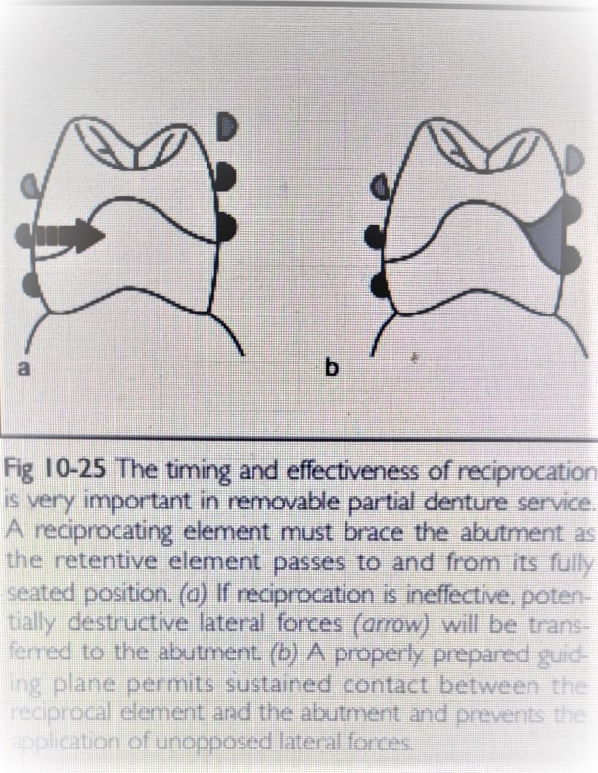
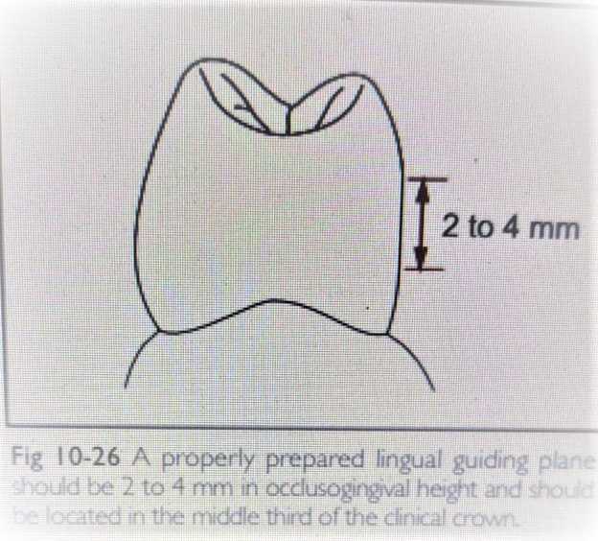

Slide 30
2.A second reason for preparing lingual guiding planes is to minimize the number of pathways by which the prosthesis may enter and exit its fully seated position.
Therefore, to enhance retention by preparing guiding planes on the lingual surfaces of the remaining teeth.
3.to provide maximum resistance to lateral forces. The more teeth that are used to stabilize the removable partial denture, the less stress will be transmitted to any individual tooth.

Slide 31
d.Anterior abutment teeth
to enhance stabilization of the prosthesis, to decrease undesirable space between the prosthesis and an abutment tooth, and to increase retention through frictional resistance

Slide 32
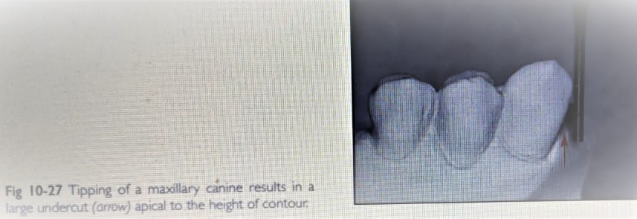

Slide 33
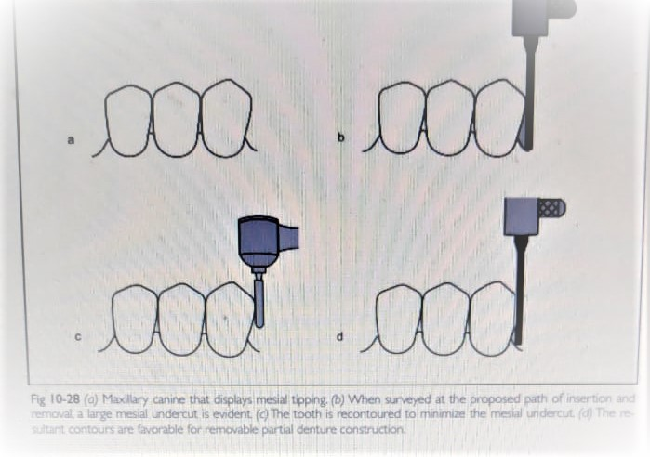

Slide 34
e. Changing height of contour
to provide more favorable positions for clasp arms or lingual plating.
Ideally a retentive clasp arm should be located no farther occlusally (or incisally) than the junction of the gingival and middle thirds of the crown.
The height of contour is best lowered by using a tapered diamond bur in a high-speed handpiece. Tooth surfaces should be smoothed using a carborundum-impregnated rubber point or wheel in a low-speed handpiece.

Slide 35
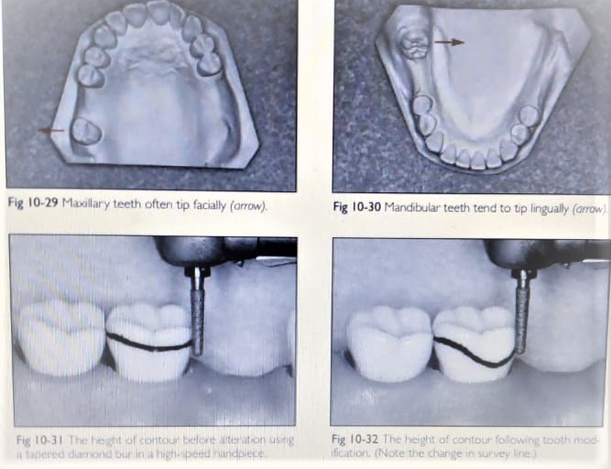

Slide 36
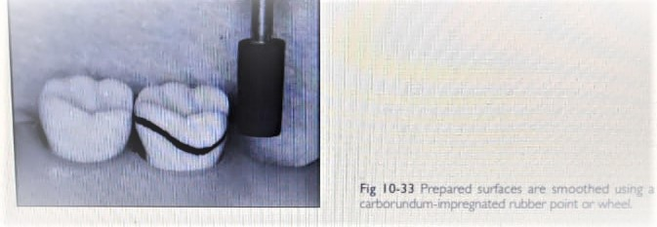

Slide 37
4. A lingual guiding plane should be 2 to 4 mm in occlusogingival height and should be located in the middle third of the clinical crown as viewed from the mesial or distal surfaces

Slide 38
f. Enhancing retentive undercut
Occasionally, a proposed abutment tooth has an insufficient retentive undercut.
Under certain conditions, tooth contours may be modified to enhance an existing undercut or create a conservative undercut. While this technique may be used in some instances, it does not have universal application.
For this technique to be successful, the facial and lingual surfaces of the tooth must be nearly vertical. Under these circumstances, a gentle depression may be created on one of these surfaces.
This depression should exhibit smooth, flowing contours. Gentle variations in contour permit retentive clasps to enter and exit a depression with relative ease. Sharply defined dimples and pits should be avoided since retentive clasps cannot flex into and out of these indentations

Slide 39
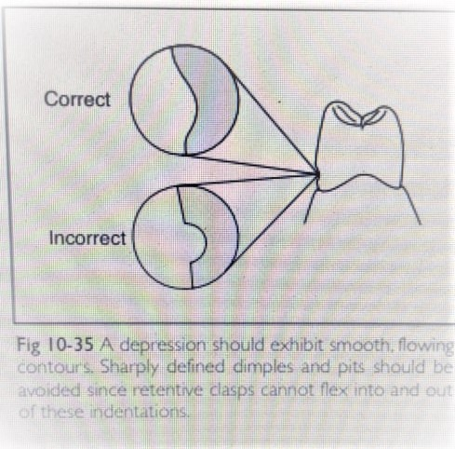
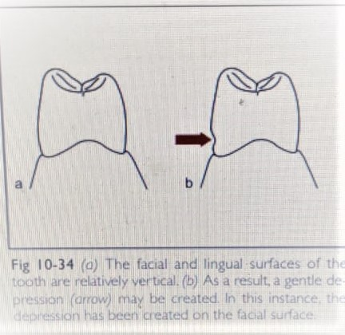

Slide 40
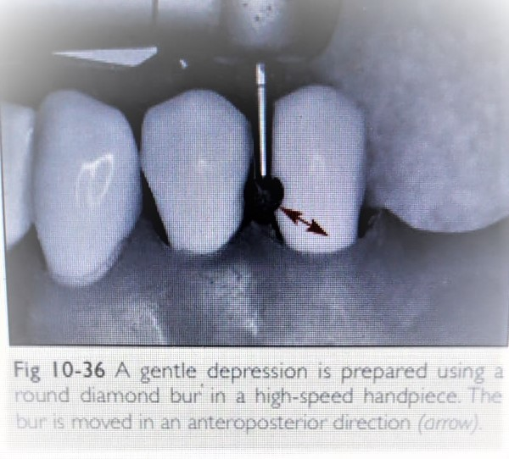
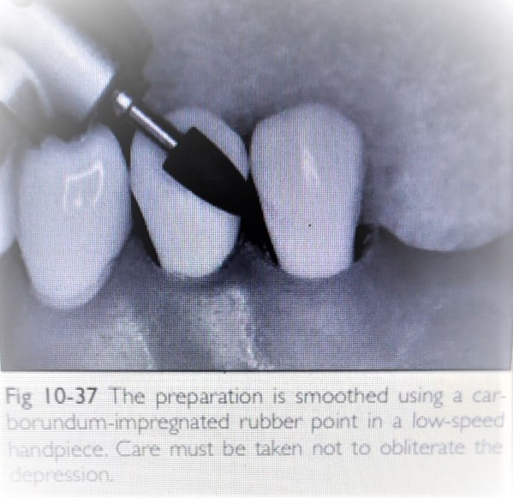

Slide 41
A suitable depression may be prepared using a round or football-shaped diamond bur in a high-speed handpiece. The bur should be moved in an anteroposterior direction near the line angle of the tooth.
The resultant depression should be parallel to the gingival margin and as close to the margin as is practical. The depression should be approximately 4 mm in mesiodistal length and 3 mm in occlusogingival height.
More importantly, it should establish an undercut of 0.010 inches relative to the proposed path of insertion. The preparation should be polished with a carborundum-impregnated rubber point.
Extreme care must be exercised during the polishing procedure since poor polishing technique may obliterate the depression

Slide 42
g. Complete- and partial-coverage restorations
Restorations may be required for teeth displaying caries lesions, defective restorations, fracture, or endodontic therapy. If the remaining teeth do not possess usable contours and the enamel surfaces cannot be modified to produce these contours, complete- or partial-coverage restorations also may be required.
Recontouring must include the preparation of guiding planes and rest seats.
the placement of guiding planes should always precede the preparation of teeth that are to receive fixed restorations

Slide 43
shaping the wax pattern
to create a wax pattern with the desired contours, an accurate cast is essential.
This cast must include a properly prepared die that is correctly related to the remainder of the dental arch.
To accurately assess the contours of the wax pattern, the pattern is dusted with a thin layer of powdered wax or zinc stearate.
The height of contour is then marked using the analyzing rod in the vertical arm of the surveyor.
Following evaluation of contours, the pattern is reshaped using wax carving instruments .
Contours created during this process should be as ideal as possible

Slide 44
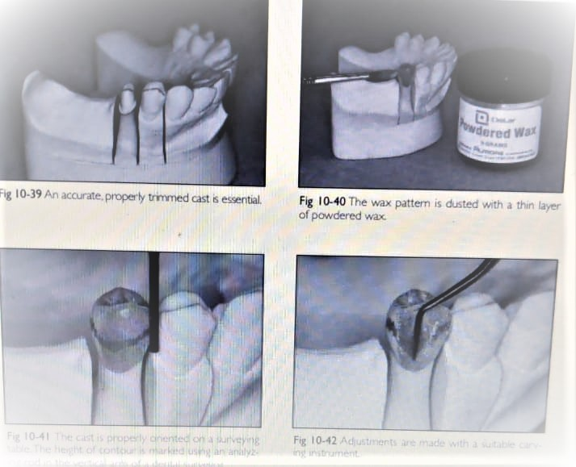

Slide 45
The desired undercut is developed and its depth is verified using the appropriate undercut gauge.A 0.010-inch undercut is recommended for the majority of removable partial denture alloys.
The undercut should be located at the mesial line angle or the distal line angle in most instances.When using an I-bar clasping system, the undercut may be positioned at the midfacial (or, rarely, at the midlingual) line angle

Slide 46
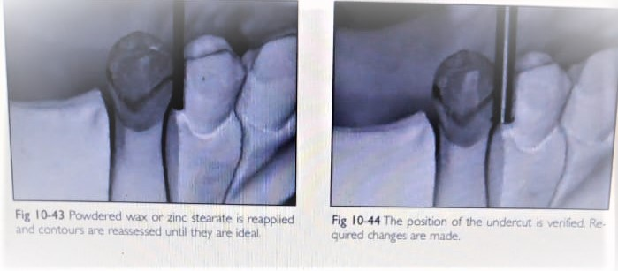

Slide 47
At this stage, the required guiding planes are prepared on the wax pattern.
These surfaces generally are created and refined using a wax knife in the vertical arm of the surveyor.
Extreme care must be taken to ensure that these surfaces are parallel to the guiding surfaces previously prepared on the remaining natural teeth.
When the practitioner is satisfied with the axial contours of the wax pattern, required rest seats are placed. This is most easily accomplished using a small, round bur in conjunction with a discoid carver.
Each rest seat should display the appropriate geometry, depth, and contour.

Slide 48
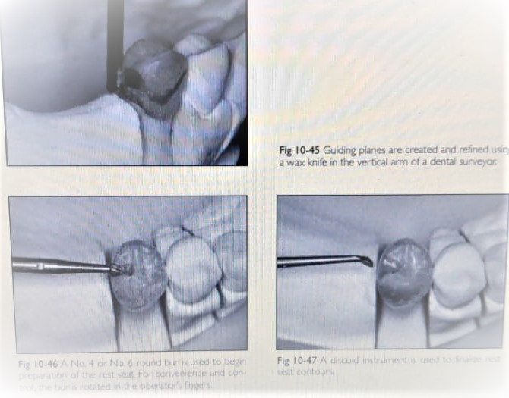

Slide 49
As a final measure, the wax pattern is reexamined.
The occlusion is evaluated to ensure its suitability.
Rest seats are carefully inspected for proper form and depth. Axial contours are assessed and refined as necessary.
At this stage, the wax pattern is gently cleaned with damp cotton.
All contours are inspected once again, and the pattern is prepared for the casting process.

Slide 50
Refining the cast restoration
After the casting has been made, it is carefully recovered and finished.
Contours that were established in the wax pattern should be preserved.
To ensure that the proper anatomy has not been lost, the casting is fitted to the master die and properly positioned on the accompanying cast.
The cast is returned to the surveying table and positioned at the prescribed tilt.
The height of contour and guiding planes are examined using the analyzing rod in the vertical arm of the surveyor.
The position and depth of the undercut are verified using an appropriate undercut gauge .
If changes in contour are noted, these changes must be corrected using carefully controlled finishing and polishing techniques.
If changes are so great that the appropriate contours cannot be reestablished, the waxing and casting procedures must be reaccomplished

Slide 51
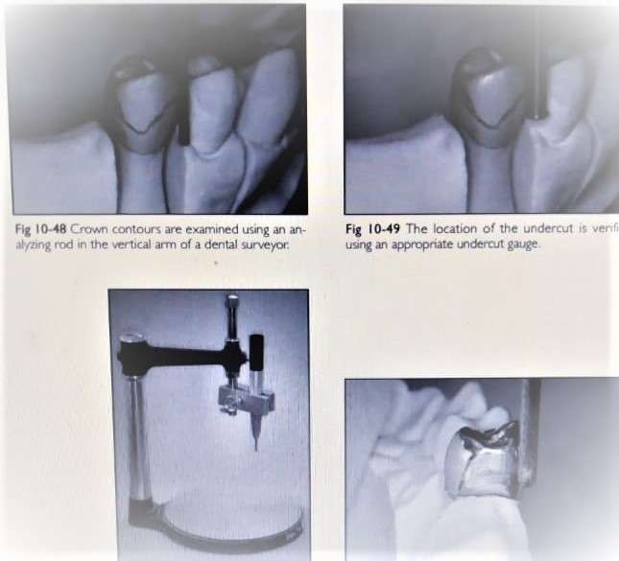

Slide 52
If the restoration displays the appropriate contours, it may be finished and polished.
Upon completion of polishing procedures, guiding planes are refined once again

Slide 53
Summary
Mouth preparation appointments must be planned with the goal of conserving as much time as possible.
The following discussion is arranged in the order that mouth preparation procedures are normally performed

Slide 54
References
Removable partial prosthodontics 11th edition Mc cracken
Clinical removable partial prosthodontics stewarts
A color atlas of removable partial dentures J.C. Davenport ; R.M. Basker
Advanced Removable Partial Dentures James S. Brudvik
Arthur M. LaVere, and Arthur J. Krol, Selection of a maior connector for the extension-base removable partial denture JPD 1973;30,102-105
Davis Hendersonand Thomas E. Seward Design and force distribution with removable partial dentures: A progress report JPD 1967;17,350-364.

